Slide 1
Physics-II
15B11PH211
Electromagnetic Theory
Statistical Distributions and Lasers
Solid State Physics

Slide 2
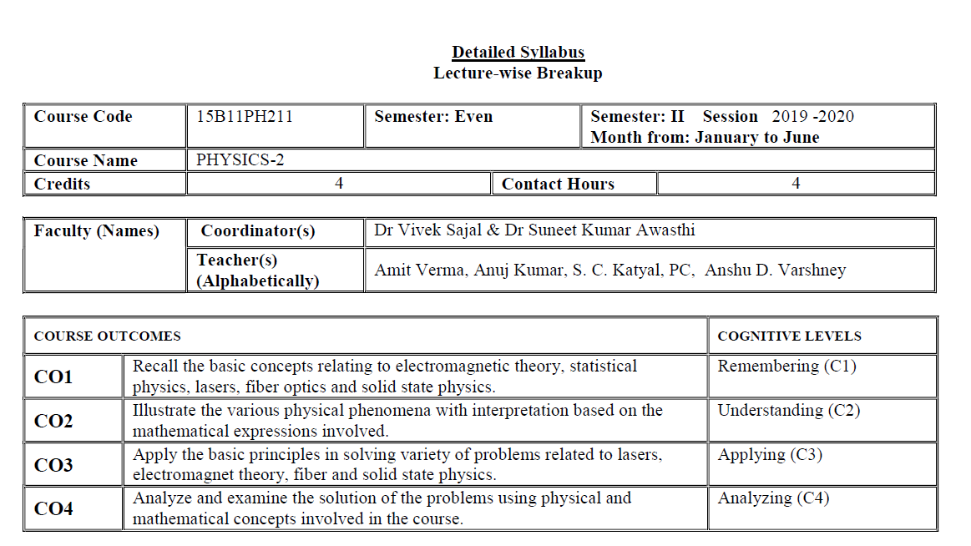

Slide 3
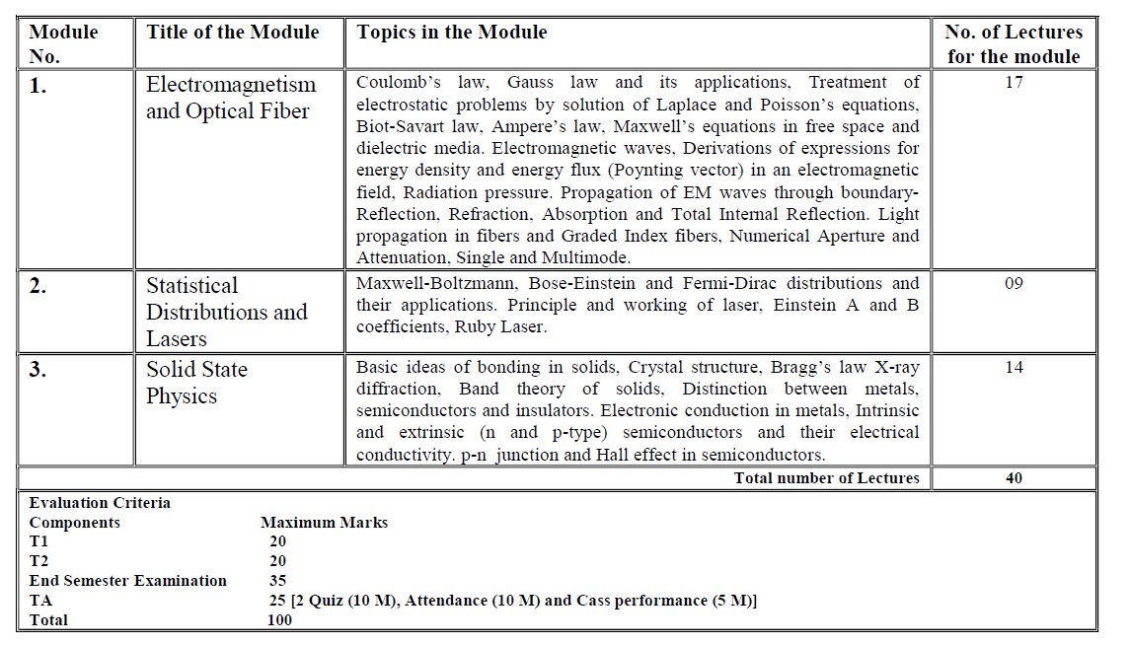

Slide 4
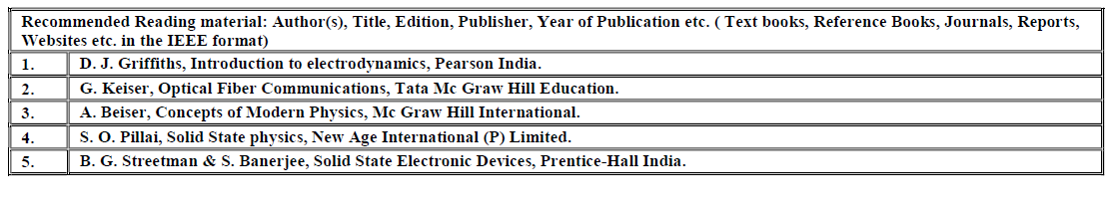

Slide 5
Books:
Introduction to Electrodynamics
by D.J. Griffith
Engineering Electromagnetic
by William H. Hayt & J A Buck
Principles of Electromagnetics
by Matthew N. O. Sadiku
Electromagnetics
by Edminister (Schuam Outline series)

Slide 6
To understand the Electromagnetic, we must know basic vector algebra and coordinate systems. So let us start the coordinate systems.
COORDINATE SYSTEMS
RECTANGULAR or Cartesian
Choice is based on symmetry of problem
CYLINDRICAL
SPHERICAL
Examples:
Sheets - RECTANGULAR
Wires/Cables - CYLINDRICAL
Spheres - SPHERICAL

Slide 7
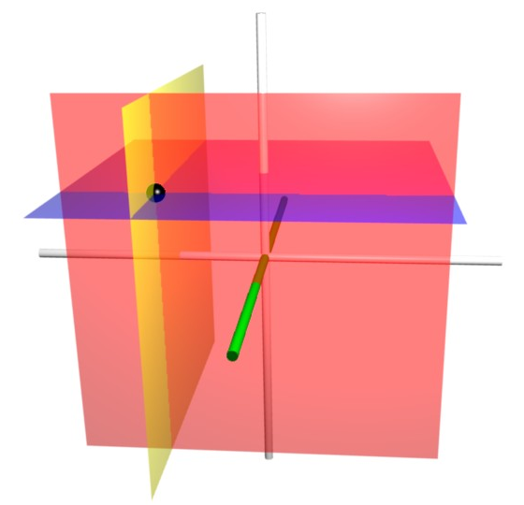
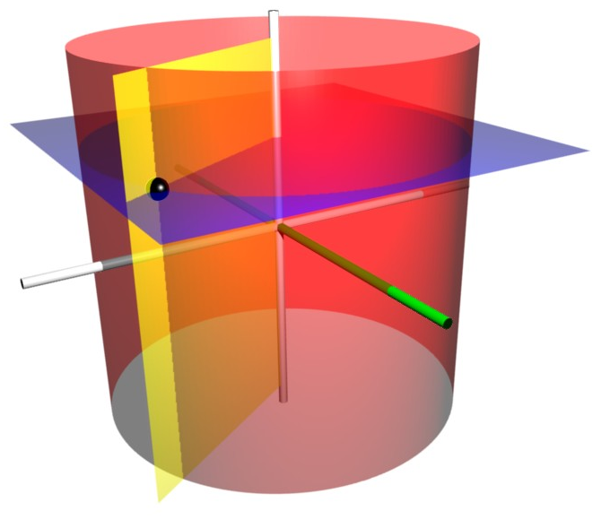
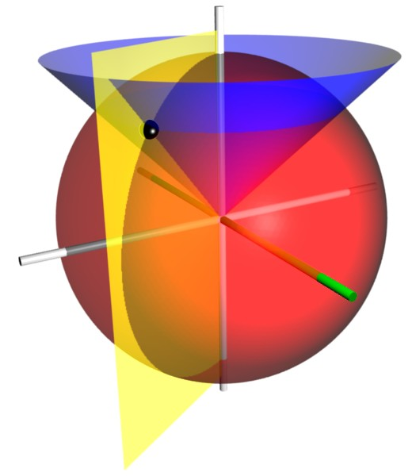
Orthogonal Coordinate Systems:
1. Cartesian Coordinates
z
Or
P(x,y,z)
y
Rectangular Coordinates
P (x, y, z)
x
z
z
P(r, ϕ, z)
2. Cylindrical Coordinates
P (r, ϕ, z)
r
y
x
Φ
z
3. Spherical Coordinates
P(r, θ,ϕ)
P (r, θ, ϕ)
θ
r
y
x
Φ

Slide 8
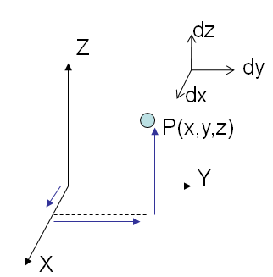
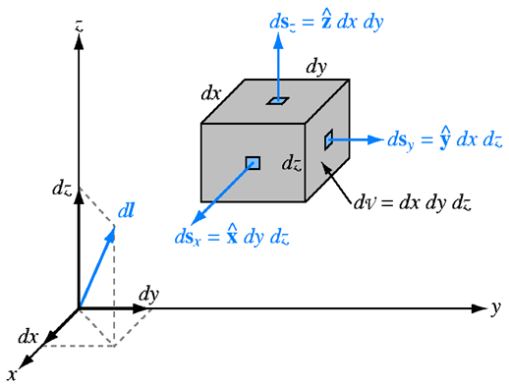
Cartesian Coordinates
Differential quantities:
Deduce the area of the lamina
y
6
2
3
7
x

Slide 9
Cartesian Coordinates
Differential quantities:

Slide 10
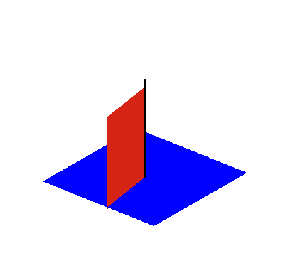
Cylindrical coordinate system (r,φ,z)
Z
Z
r
Y
φ
X

Slide 11
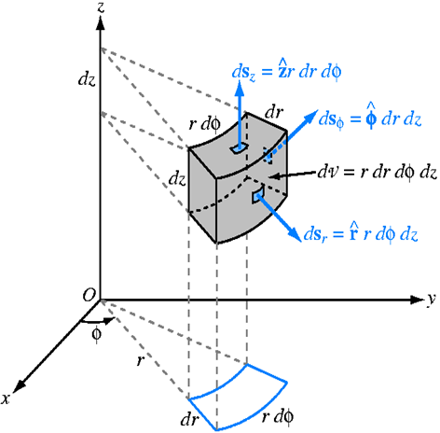
Cylindrical Coordinates: Visualization of Volume element
Differential quantities:
Limits of integration of r, φ,z are 0<r<∞ , o<φ <2π ,0<z <∞

Slide 12
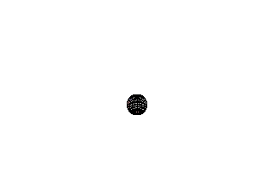
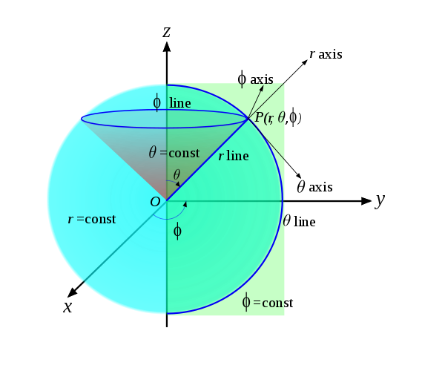


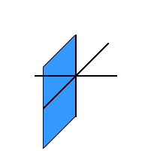
Spherical coordinate system (r, θ,φ)
Radius=r
0<r<∞
-Zenith angle
0<θ <π
( starts from +Z reaches up to –Z) ,
ϕ -Azimuthal Angle
0<φ <2π
(starts from +X direction and lies in x-y plane only)

Slide 13
Spherical Coordinates
P(r, θ, φ)
Z
dr
r cos θ
P
θ
r
r dθ
dθ
Y
dφ
φ
r sinθ
r sinθ dφ
X

Slide 14
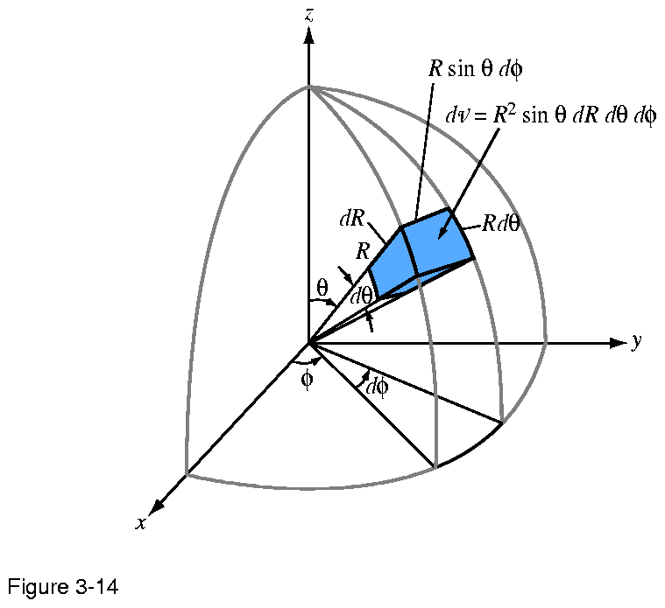
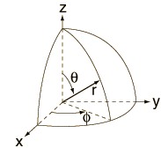
Spherical Coordinates
Differential quantities:

Slide 15
Points to remember

Slide 16
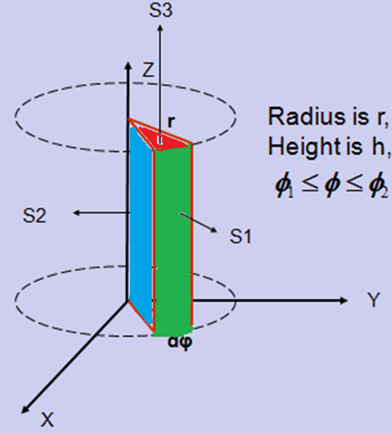
Determine
a) Areas S1, S2 and S3.
b) Volume covered by these surfaces.

Slide 17
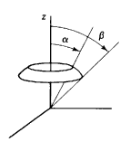
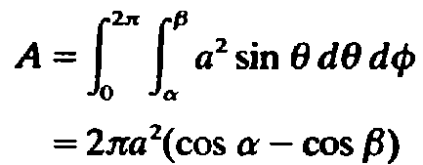
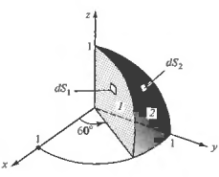
Ex: Use the spherical coordinate system to find the area of the strip α≤ θ ≤ β on the spherical shell of radius a. What results when α= 0 and β = π?
Ex: Use spherical coordinates to write the differential surface areas dS₁ and dS₂ and then integrate to obtain the areas of the surfaces marked 1 and 2.
Ans : π/4,π/6

Slide 18
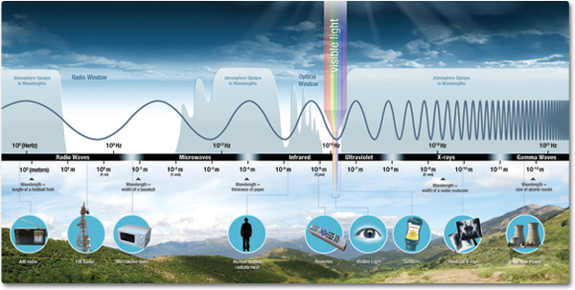
Books:
Introduction to Electrodynamics
by D.J. Griffith
Electromagnetics
by Edminister (Schuam series)
Principles of Electromagnetics
by Matthew N. O. Sadiku
Engineering Electromagnetic
by W H Hayt & J A Buck
Notes:
When you tune your radio, watch TV, send a text message, or pop popcorn in a microwave oven, you are using electromagnetic energy. You depend on this energy every hour of every day. Without it, the world you know could not exist

Slide 19
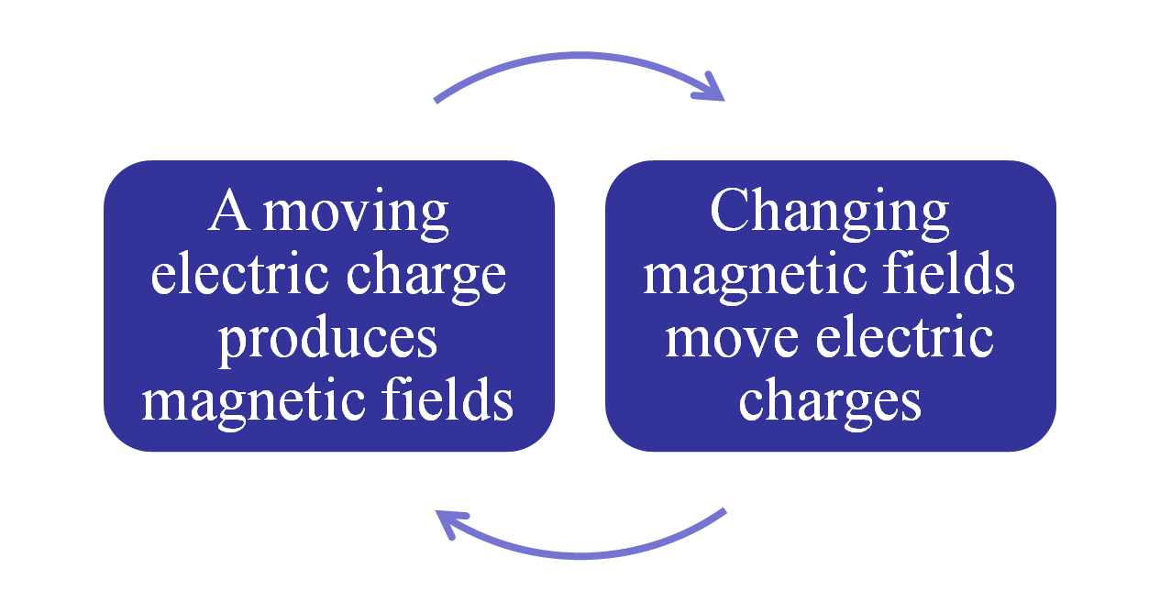
ELECTRICITY AND MAGNETISM ARE DIFFERENT ASPECTS OF ELECTROMAGNETISM

Slide 20
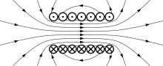
Electromagnetism
A fundamental interaction between the magnetic field and the presence and motion of an electric charge
A “Field” is any physical quantity which takes on different values at different points in space.

Slide 21
Topics to be covered in Lecture 2:
Basics of fields
Gradient
Divergence
Curl.
Physical significance of Gradient, divergence and curl

Slide 22
Vector Analysis
Given A = a_{x} + a_{y} , B=a_{x}+2a_{y}, and C=2a_{y}+a_{z},
find (A x B) x C and compare it with A x (B x C).
find А.В x С and compare it with A x В.С
Scalar and Vector Fields
voltage, current, energy, temperature
velocity, momentum, acceleration and force

Slide 23
Gradient, Divergence and Curl
The Del Operator ∇
Gradient of a scalar function is a vector quantity.
Divergence of a vector is a scalar quantity.
Curl of a vector is a vector quantity.

Slide 24
Operator in Cartesian Coordinate System
gradT: points the direction of maximum increase of the function T.
Divergence:
Curl:
where

Slide 25
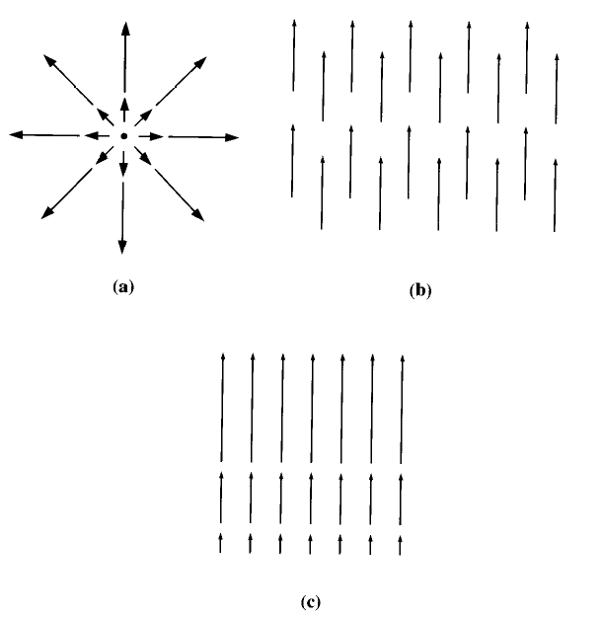
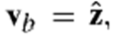
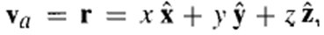
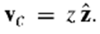
Divergence

Slide 26
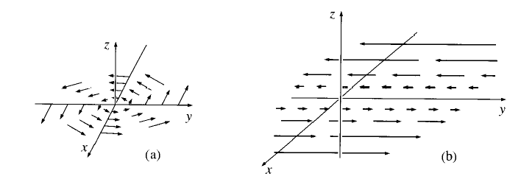
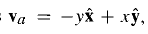
Curl

Slide 27
Operator in Cylindrical Coordinate System
Gradient:
Divergence:
Curl:

Slide 28
Operator in Spherical Coordinate System
Gradient :
Divergence:
Curl:

Slide 29
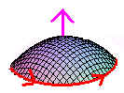
Fundamental theorem for divergence and curl
Gauss divergence theorem:
Stokes curl theorem
Conversion of volume integral to surface integral and vice verse.
Open S
Closed L
Conversion of surface integral to line integral and vice verse.
Notes:
1. The Gauss divergence theorem states that the total outward flux of a vector field ‘V’ through the closed surface ‘a’ is the same as the volume integral of the divergence of V.
2. Stokes’s theorem states that the circulation of a vector field V around a closed path L is equal to the surface integral of the curl of V over the open surface S bounded by L

Slide 30
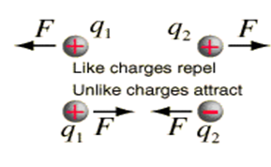
Coulomb’s Law
Like charges repel, unlike charges attract
Exercise: A charge Q₁= 1nC is located at the origin in free space and another charge Q at (2,0,0). If the X-component of the electric field at (3,1,1) is zero, calculate the value of Q. Is the Y component zero at (3,1,1)?
Calculate E due to
Dipole,
Rod (line charge), Ring (Line charge),
Circular plate (surface charge), Square sheet,
Sphere or Cylinder (Volume charge density)

Slide 31
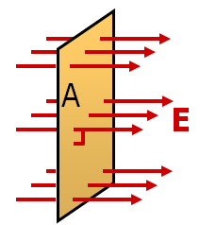
Electric Flux
The number of electric field lines through a surface
A
Φ_{E}=EA,
θ
E
θ
Conclusion:
The total flux depends on
strength of the field,
the size of the surface area it passes through,
and on how the area is oriented with respect to the field.

Slide 32
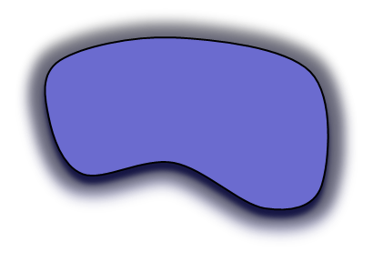
Gauss' Law
The total of the electric flux out of a closed surface is equal to the charge enclosed divided by the permittivity (ε_{o.}).
ε_{o} = the permittivity of free space 8.854x10⁻¹² C²/(N m²)
da
Integral Form
E
+q
Differential Form
where

Slide 33
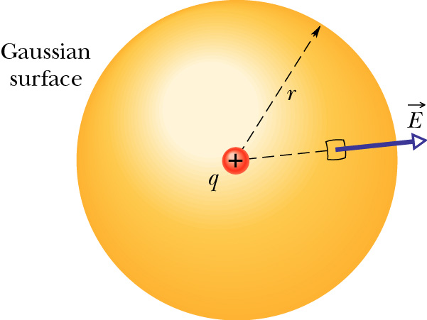
Electric lines of flux and Derivation of Gauss’ Law using Coulomb’s law
Consider a sphere drawn around a positive point charge. Evaluate the net flux through the closed surface.
Net Flux
For a Point charge
dA
Gauss’ Law

Slide 34
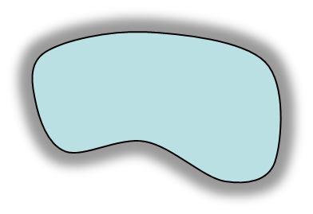
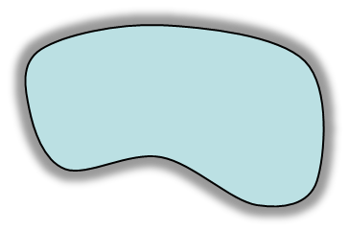
Asmnt 1:
Proof of the Gauss’s law for the charge inside
da
E
+q
and outside the Gaussian surface
+q
A
C
da
da
E
B
D
Where dΩ is solid angle

Slide 35
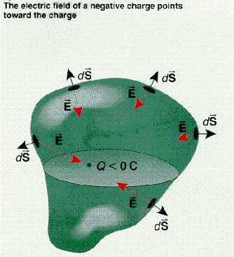
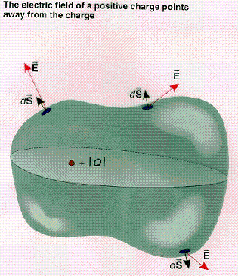
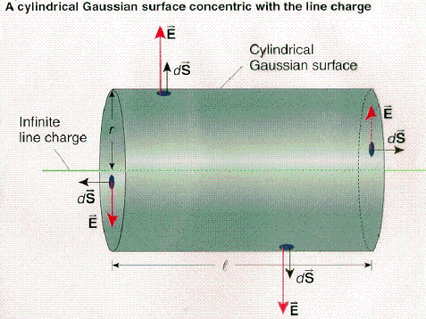
+ve Flux
-ve flux

Slide 36
Differential form of Gauss Law:
Proof:
Gauss Law
Gauss divergence theorem:
or
Note: Gauss law is also known as Maxwell’s first equation.

Slide 37
Quiz:
(a) 1.12 x 10⁵ Vm, (b) 1.86 x 10⁴ Vm,
-10⁻⁴ Vm

Slide 38
Remember
Electric Flux (φ=E⊥A=EA cosθ= q/ε₀)
Flux is independent of the distance of a point from position of charge.
Electric Flux is the number of electric field lines crossing per unit area.
For Φ_{max}; EA ⇒ θ=0º.
For Φ_{min}; EA=0 ⇒ θ=90º
Gauss Law is Maxwell’s first equation.
Conductors in electric Field;
E _{inside}=0 as net charge is distributed over the surface of a conductor.
At the surface of conductor; perpendicular E only, no parallel component of E.

Slide 39

Applications of Gauss law -Spherical and Cylindrical symmetries

Slide 40
Applications of Gauss law (Spherical distribution systems)
Conducting Sphere of charge ‘q’ and radius ‘R’:
E at an external point: E_{o}
E at the surface: E_{s}
E at an internal point: E_{i}
Nonconducting Sphere
E at an external point: E_{o}
E at the surface: E_{s}
E at an internal point: E_{i}

Slide 41


(Spherical systems: Conducting Sphere)
Conducting Sphere of charge ‘q’ and radius ‘R’:
E at an external point: E_{o} r>R
E at the surface: E_{s} r=R
E at an internal point: E_{i} r<R
Gaussian surface
Case-I: E at an external point;
Net electric fux through ‘P’:
R
r
P
S₁
The Electric field strength at any point outside a spherical charge distribution is the same as through the whole charge were concentrated at the centre.

Slide 42


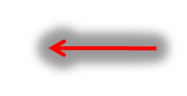
(Spherical systems: Conducting Sphere)
Gaussian surface
Case-II: E at the Surface;
r=R
Gaussian surface
Case-III: E at an internal point;
R
r

Slide 43
(Spherical systems: Nonconducting Sphere)
Nonconducting Sphere of charge ‘q’ and radius ‘R’:
E at an external point: E_{o} r>R
E at the surface: E_{s} r=R
E at an internal point: E_{i} r<R
Case-I: E at an external point;
Net electric flux through ‘P’:
Gaussian surface
R
r
P
S1

Slide 44
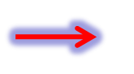
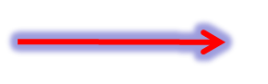
(Spherical systems: Nonconducting Sphere)
Case-II: E at the Surface;
Gaussian surface
r=R
Case-II: E at an internal point;
Gaussian surface
R
r

Slide 45
(Spherical systems: Conducting Sphere)
R
r
P
E
r=0
r=R
r
(Spherical systems: Nonconducting Sphere)
R
r
P
E
r=0
r=R
r

Slide 46
Numerical
R
Ei
Eo
Es
Solid sphere

Slide 47
Problems: Spherical Symmetry
Determine Electric field everywhere by using Gauss Law for the following;
1. Non conducting solid sphere of radius R and charge density ρ=k/r^{2,} Where k is a constant.
2. Non conducting spherical shell of inner radius r₁, outer radius r₂ and charge density ρ= k/r² , where k is a constant. Also determine Max E at any value of r .
R
E3
Ei
Eo
E1
Es
E5
E2
Solid sphere
E4
Spherical shell

Slide 48

Applications of Gauss law (Cylindrical distribution systems)
Conducting long Cylinder of charge ‘q’ and radius ‘R’:
E at an external point: E_{o}
E at the surface: E_{s}
E at an internal point: E_{i}
Nonconducting long Cylinder
E at an external point: E_{o}
E at the surface: E_{s}
E at an internal point: E_{i}

Slide 49
Cylindrical distribution systems: Conducting Cylinder
Conducting long Cylinder of charge ‘q’ and radius ‘R’ :
E at an external point: E_{o} r>R
E at the surface: E_{s} r=R
E at an internal point: E_{i} r<R
Gaussian
surface
Case-I: E at an external point;
Net electric flux through ‘P’:
l
E
R
O
P
r

Slide 50
Case-II: E at the Surface;
Case-III: E at an internal point;
l
E
R
O
P
E
E_{s}
E_{o}
E_{i}=0
r=0
r=R
r

Slide 51
Cylindrical distribution systems: Nonconducting Cylinder
Nonconducting Cylinder of radius ‘R’, height ‘l’ and charge density ‘ρ’:
E at an external point: E_{o} r>R
E at the surface: E_{s} r=R
E at an internal point: E_{i} r<R
Case-I: E at an external point;
Net electric flux through ‘P’:
Gaussian
surface
l
E
R
O
P
r

Slide 52
Case-II: E at the Surface;
Case-III: E at an internal point;
l
E
R
O
P
E
E_{s}
E_{i}
E_{o}
r=0
r=R
r

Slide 53
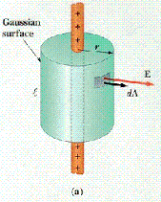
For infinite long line charge density ‘λ’

Slide 54
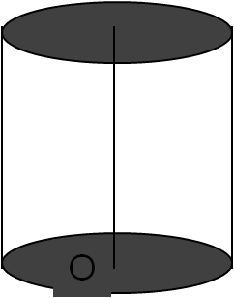
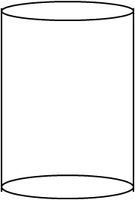
Numerical: Non conducting Cylindrical shell (r₁, r₂ and height h) having volume charge density ρ=k/r. Determine E everywhere.
Case-I: E at an external point r₀; E₀
Gaussian
surface
l
E
P
r₁
r₂
r₀

Slide 55
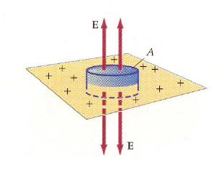
Applications of Gauss law (Infinitely long sheet of Charge)
The plane is infinitely large, any point can be treated as the center point of the plane, so E at that point must be normal to the surface and must have the same magnitude at all points equidistant from the plane.

Slide 56
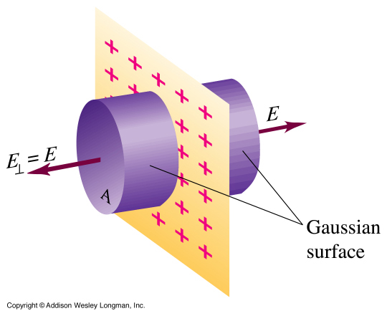
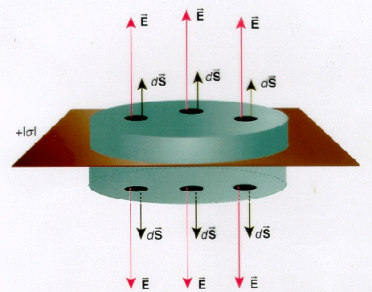
A cylindrical Gaussian surface is used to find the electric field of an infinite plane sheet of charge.
Assume the surface charge density is σ.
‘E’ does not depend on the distance ‘r’. Therefore, the field is uniform everywhere.

Slide 57
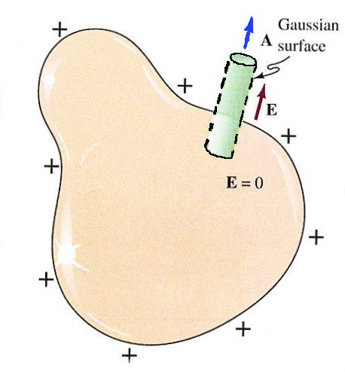
Electric field just outside the surface of a charged conductor
Assume the surface charge density is σ.
σ

Slide 58
Find the field in each of three regions
(i) to the left of both
(ii) between them
(iii) to the right of both
+σ
+σ
-σ
+σ
E₊ E₊ E₊ E₊
E₊ E₊ E₊ E₊
E₋ E₋ E₋ E₋
E₊ E₊ E₊ E₊
(1)
(2)
0
0
0
-σ
-σ
E₋ E₋ E₋ E₋
E₋ E₋ E₋ E₋
(3)
0

Slide 59
Quiz
For a conducting sphere: with surface charge density ‘σ’ and radius R, determine E_{o}, E_{s} and E_{i}.
For a spherical shell volume charge density is ρ =k/r for a≤r≤b otherwise zero. determine E for each region.
For a cylinder of radius ‘R’ and height ‘h’ volume charge density is ρ =kr. Determine E_{o}, E_{s} and E_{i}
Electric field in inside and just outside (very close) of the surface of a charged conductor
Inside E=0, Outside E= σ/ε₀

Slide 60
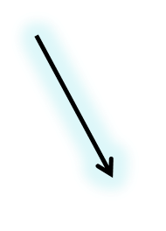
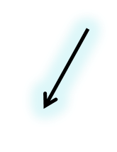
Line integral of Electric field: Electric Potential
Electric field at a field point r, due to a point charge at origin:
The electric potential at a distance r from the point charge is the work done per unit charge in bringing a test charge from infinity to that point.

Slide 61
Surface over which Potential is constant is called an equi-potential surface.
Reference point : V(∞)=0 convention at infinity.
Superposition principle: V=V₁+V₂+…..
Unit: Nm/C or Joule/C or VOLT
Curl of E ?
The integral around a closed path is zero
Using Stokes’ theorem
In electrostatics only.
→ no moving charge or current

Slide 62
Poisson's and Laplace's Equation
The electric field is related to the charge density
The electric field is related to the electric potential
Therefore the potential is related to the charge density by
∇² : Laplacian operator.

Slide 63

Conversion from one to another
ρ
E
V

Slide 64
Note: Laplace’s Operator

Slide 65
Show that potential function V(x,y,z) or V(r) satisfies the Laplace’s equation.

Slide 66

Find the potential inside and outside a spherical shell of radius R, which carries a uniform surface charge. Set the reference point at infinity.
Notice that the potential is not zero inside the shell , even though the field is. V is constant in this region, so that ∇V=0

Slide 67
Calculate the numerical value for V and ρ_{v} at point P in free space if (D 7.1 (page 175, 7th Ed. Hayt)
Ans: (a) 12V, - 106.2 pC/m³
(b) -22.5V, 0
(c) 4V, 0

Slide 68
Numerical
Does potential function 2(x²-y²+z) satisfies Laplace’s equation?
Determine potential outside a charged conducting sphere of radius R, using Laplace’s equation.
Given V=V₀ at r=R
= 0 at r=infinite.
Ans: Yes

Slide 69
Solution:

Slide 70
Applications: Laplace’s and Poisson’s equation
In Cartesian or Rectangular coordinates
Z
One dimensional solution of Laplace’s Equation in rectangular coordinate system
Let V be a function of z only. Then Laplace’s Equation reduces to
Equation (3) represents a family of equi – potential surfaces with z taking up constant values.

Slide 71
Applications: Laplace’s and Poisson’s equation
Consider two such equi – potential surfaces one at z = z₁ and the other at z = z₂.
Let V= V₁ at z = z₁ and V = V₂ at z = z₂
Z
This is the case with a parallel plate capacitor with a plate separation of z₁ ~ z₂ = d and a potential difference V₁ ~ V₂ .
Applying the above two conditions, called boundary conditions, we get,
Let , V₁ = 0 at z₁ = 0 and V₂ = V_{a} at z₂=d
V = V₂ = V_{a}
z=z₂
d
V = V₁ = 0
z₁=0
We find that V is a linear function of z
Fig 1 Parallel plate capacitor
Similarly, V as a function of x or y the solution of the Laplace’s equation can be solved.

Slide 72
Two infinite conducting planes are parallel to the YZ plane. One of the plane is at x = 0 and is kept at a potential V _{o} . The other plane is located at x = d and is kept at a constant potential V_{d}. The region between them is filled with volume charge density ρ=ρ_{o} (x/d)². Find the potential V between the plates using Poisson’s equation.

Slide 73
Applications: Laplace’s and Poisson’s equation
In Cylindrical coordinates: r dependent only
Now, in cylindrical coordinates, the Laplace’s equation becomes
Consider V is a function of r only . Thus the Laplace’s equation reduces to
From this equation, we observe that equipotential surfaces are given by r = constant and are cylinders. Example of the problem is that of a coaxial capacitor or coaxial cable.

Slide 74



Applications: Laplace’s and Poisson’s equation
In Cylindrical coordinates: r dependent only
Let us create the boundary conditions by choosing
V = V_{a} at r = a and V = V_{b} at r = b, b > a.

Slide 75


Applications: Laplace’s and Poisson’s equation
In Cylindrical coordinates: ϕ dependent only
Consider V as a function of Φ only.
From this equation, we observe that equipotential surfaces
are given by Ф = constant planes,
Choose two such equipotential surfaces, V = V_{a} at Ф = α and V = 0 at Ф = 0. Example: corner reflector antenna ,Used in communication systems.

Slide 76

Applications: Laplace’s and Poisson’s equation
In Spherical coordinates: r dependent only
Consider that V is a function of r only. Laplace’s equation reduces to
where A and B are arbitrary constants to be evaluated. This equation represents a family of equi – potential surfaces for r = constant.
Let us choose two such equi-potential surfaces at r = a and r = b, b > a , such that at
r = a, V = V_{a} and at r = b, V = V_{b}

Slide 77
Applications: Laplace’s and Poisson’s equation
In Spherical coordinates: r dependent only
This is an example of concentric spheres or Spherical capacitor

Slide 78
Applications: Laplace’s and Poisson’s equation
In Spherical coordinates: θ dependent only
Finally let us consider V as a function of θ only . In this case the Laplace’s equation reduces to
Integrating once again, we get,
This equation represents a family of equi-potential surfaces for constant θ. Let us consider two such equi-potential surfaces at θ =π/2, V = 0 and at θ = α, V = V_{a}.

Slide 79


Applications: Laplace’s and Poisson’s equation
In Spherical coordinates: θ dependent only
The equi-potential surfaces are cones as shown in figure below.
Such a system is called a conical antenna
Applying these two boundary conditions to the equation (i) and solving it for A and B, substituting these values in (i),we get,

Slide 80
Electrostatic Boundary Conditions
E
For an infinite plane carrying uniform surface charge σ
Discontinuity
y
E
Discontinuity
For a spherical shell of radius R, carrying uniform surface charge σ
R
r

Slide 81
Electrostatic Boundary Conditions
A
σ
ε
Conclusion : The normal component of E is discontinuous by an amount σ/ε₀ at any boundary.

Slide 82
Electrostatic Boundary Conditions
σ
ε
l

Slide 83
Force on the surface of conductor
Electric Field outside a conductor
Note1: Force on a charge q (or surface charge density σ) placed in an external field E :
Note 2: “ But E is discontinuous across a surface charge distribution” Therefore
On the surface, force per unit area :
In our case: E_{above}=σ/ε₀ and E_{below} is zero. Hence Force (per unit area) on the conductor surface:

Slide 84
Prob. 2.37:
Two large metal plates (each of area A) are held a distance d apart. Suppose we put a charge Q on each plate, what is the electrostatic pressure on the plates ?
Assignment:
Define the following
Biot-Savart law,
Ampere’s circuital law
Transverse nature of light

Slide 85




Biot-Savart Law
Currents, i.e. moving electric charges, produce magnetic fields. There are no magnetic charges

Slide 86
MAGNETIC FLUX
It is defined as the magnetic lines of force produced in the medium surrounding electric currents or magnets and is expressed as surface integral of the magnetic flux density.
The unit of magnetic flux is T.m² ( weber).
B is defined as magnetic flux per unit area (Magnetic flux density) through a loop of small area
Gauss’ law for magnetic fields** says there can not be a net magnetic flux through the surface since there can be no net magnetic charge enclosed by the surface. ⇒ magnetic monopoles do not exist.
** Maxwell’s II equation

Slide 87
Solution:
φ = 2√2=2.83 wb

Slide 88

Ampere’s Circuital Law** in Integral Form
Ampere’s Circuital Law -“the circulation of the magnetic flux density in free space is proportional to the total current through the surface bounding the path over which the circulation is computed.”
Note: ** Ampere’s circuital Law is Maxwell’s IV equation.

Slide 89
3. Faraday’s Law **
Changing magnetic field gives rise to electric current.
B (increasing)
Loop
E ^
EMF(V_{e})
B (increasing)
>
^
I
<
Field by I
Note: ** Faraday’s Law is Maxwell’s III equation.

Slide 90
0
Need modification in ampere’s law

Slide 91

Modification to Ampere’s Law:
-Ampere’s law must be wrong!
- it depends on what “enclosed” means
Surface S1 encloses a current
Surface S2 does not!
What if we moved S1 into the gap?
How can we modify the rule
to handle all situations?

Slide 92


Modified Ampere’s Law
To see how the displacement current comes about, one has to consider the electric flux through the capacitor’s plate (Gauss’s Law).
As ‘Q’ increases on the capacitor, the electric flux also increases

Slide 93
Modified Ampere’s Law:
I
I
What does B-field look like in this region?

Slide 94
Modified Ampere’s Law:
E-field increasing
I
•
•
•
•
•
•
•
•
•
•
•
•
•
•
•
•
•
•
•
•
•
•
•
•
•
•
•
•
•
•
•
•
•
•
•
•
•
•
What does B-field look like in this region?
B-field forms concentric rings with direction given as shown.

Slide 95
CONTINUITY EQUATION
From the principle of charge conservation, the time rate of decrease of charge with in a given volume must be equal to the net outward current flow through the surface of the volume.
Q_{in} is the total charge enclosed by the closed surface.
Using the divergence theorem

Slide 96
Maxwell’s (need of ) modification of Ampere’s Law
Applying Stroke's theorem to left-hand side of above equation
Differential form of Ampere’s Law

Slide 97

Taking divergence of above equation
Since R.H.S. of above equation is not zero**, so let us apply Continuity equation and Gauss’s law (Electrostatics) we get
Hence
Hence modified Ampere’s Law (differential form)
**Note: Fundamental theorem of vector analysis;

Slide 98

Exercise:
Write Maxwell’s equations in integral form and obtain their differential form by using vector analysis. Write statement and physical significance of every equation.

Slide 99
Maxwell’s Equations in Integral Form

Slide 100
Proof: Differential form
Use equation 1 and apply Gauss divergence theorem
Use equation 2 and apply Gauss divergence theorem
Use equation 3 and apply Stoke’s theorem

Slide 101
Use equation 4 and apply Stoke’s theorem
Curl of B is due to current flow and a changing electric field.

Slide 102
Maxwell's Equations with Physical Interpretation
1. Relates net electric flux to net enclosed electric charge.
2. Relates net magnetic flux to net enclosed magnetic charge.
3. Relates induced electric field to changing magnetic flux.
4. Relates induced magnetic field to changing electric flux and to current.

Slide 103
Case 1: Maxwell equations in free space*
(no free charges and no currents)
* Helpful to understand Electromagnetic waves in free space.

Slide 104
Maxwell’s Equations in material media
Maxwell’s Equations in linear media (Perfect dielectric)
Inside matter, but in regions where there is no free charge or free current,
1.
2.
3.
4.
If the medium is linear
That is homogeneous ( ε and μ do not vary from point to point), and isotropic (in which μ and ε are invariant with field orientation )Maxwell’s equation reduces to
1.
2.
3.
4.

Slide 105

Derivation of Electromagnetic wave equation
Properties of E.M. Waves.
E is prependicular to k (direction of propagation); k.E=0
B is prependicular to k (direction of propagation); k.B=0
E is prependicular to B too; k × E=?
Wave Impedance E₀/B₀=c
Poynting Theorem.

Slide 106

Electromagnetic waves in free space or vacuum
Take curl of equation 3 Take curl of equation 4
106

Slide 107
Thus we conclude that light is electromagnetic in nature with electric vector E and magnetic vector B oscillating as a wave and propagating with a velocity of light in free space .
Maxwell’s equations also imply that empty space support the propagation of electromagnetic waves, traveling with speed of light.
107

Slide 108
That is the speed of electromagnetic waves in an isotropic dielectric is less than the speed of electromagnetic waves in free space.
Exercise: The relative permittivity of distilled water is 81. Calculate refractive index and velocity of light in it .

Slide 109
Solution of Electromagnetic waves in free space
The harmonic solutions to the wave equations
Where, k=2π/λ is propagation vector,
ω=2πν is angular frequency
where E_{o} and B_{o} (amplitudes of wave) space and time independent vectors but may in general be complex.
109

Slide 111

Proof:

Slide 112



Slide 113


Similarly from equation 4, we can show that
or
i.e. E is perpendicular to the Plane formed by k and B !!
Thus, k, E and B vectors are mutually perpendicular to each other.

Slide 114
Assignment : Algebraic form of Maxwell's Equations in free space
114

Slide 115

Plane Waves
We conclude that electromagnetic field vectors E and B are both perpendicular to the direction of propagation vector k. This shows that Electromagnetic waves are transverse waves, but are not mechanical waves (they do not need medium to vibrate in).
Therefore, electromagnetic waves can propagate in free space.
E_{y}
x
direction of
propagation
B_{z}
115

Slide 116


Slide 117
Monochromatic Plane Waves
Plane wave because the fields are uniform over every plane perpendicular to the direction of propagation (i.e. x = constant plane) as shown in the figure below.
or
or
E_{y}
k_{x}
B_{z}
y
E
v
x
B
z

Slide 118
Show that E and B of plane wave are in same phase at any time in space.
From equation 3
Since
But
Since ω/k is a real and positive, the electric and magnetic vectors are in phase; thus if at any instant, E is zero then B is also zero, similarly when E attains its maximum value, B also attains its maximum value, etc.
Both E_{y} and B_{z} are in same phase.
118

Slide 119
Summary of Important Properties of Electromagnetic Waves
The solutions (plane wave) of Maxwell’s equations are wave-like with both E and B satisfying a wave equation.
Electromagnetic waves travel through empty space with the speed of light c = 1/(μ₀ε₀)^{½}.
The plane wave as represented by above is said to be linearly polarized because the electric vector is always along y-axis and, similarly, the magnetic vector is always along z-axis.
y
x
direction of
propagation
z

Slide 120
The components of the electric and magnetic fields of plane EM waves are perpendicular to each other and perpendicular to the direction of wave propagation. The latter property says that EM waves are transverse waves.
The magnitudes of E and B in empty space are related by
E/B = c.
B
Both E and B are at right angles to the direction of propagation. Thus the waves are transverse.
E
k
The electric and magnetic waves are interdependent; neither can exist without the other. Physically, an electric field varying in time produces a magnetic field varying in space and time; this changing magnetic field produces an electric field varying in space and time and so on. This mutual generation of electric and magnetic fields result in the propagation of the EM waves.

Slide 121
Numerical
In free space the Electric field is given as
Determine D, B and H by using Maxwell’s equations.
Sol: Wave is propagating along x direction.
(1)
(2)
(3)
E_{y}
k_{x}
B_{z}

Slide 123
Thus, k, E and B vectors are mutually perpendicular to each other.

Slide 124

Energy in EM Waves: Poynting Theorem and Poynting Vector

Slide 125
Energy Carried by Electromagnetic Waves
Electromagnetic waves carry energy, and as they propagate through space they can transfer energy to objects in their path. The rate of flow of energy in an electromagnetic wave is described by a vector S, called the Poynting vector.*
The magnitude S represents the rate at which energy flows through a unit surface area perpendicular to the direction of wave propagation.
Thus, S represents power per unit area. The direction of S is along the direction of wave propagation. The units of S are J/(s·m²) =W/m².
*J. H. Poynting, 1884.

Slide 126
Poynting Vector in the Time Domain
We define a new vector called the (instantaneous) Poynting vector as
The Poynting vector has the same direction as the direction of propagation.
The Poynting vector at a point is equivalent to the power density of the wave at that point.
The Poynting vector has units of W/m².

Slide 127
Energy Carried by Electromagnetic Waves
y
or
or
E
Because B = E/c for EM waves in free space
S
x
B
c
z
The average of S over one or more cycles is called the wave intensity I.

Slide 128
Energy Density
The energy densities (energy per unit volume) associated with electric field and magnetic fields are:
Using B = E/c and c = 1/(μ₀ε₀)^{½} we can write
Conclusion: For an electromagnetic wave, the instantaneous energy density associated with the magnetic field equals the instantaneous energy density associated with the electric field.
Hence, in a given volume the energy is equally shared by the two fields.
The total energy density is equal to the sum of the energy densities associated with the electric and magnetic fields:

Slide 129
Relation between S and U
When we average this instantaneous energy density over one or more cycles of an electromagnetic wave, we again get a factor of ½ from the time average of cos²(kx - ωt).
and
Recall
Hence
Energy flux=energy density × c
The intensity of an electromagnetic wave equals the average energy density multiplied by the speed of light.

Slide 131


1 pascal (Pa) = 1 N/m² = 1 kg/(m·s²)

Slide 132
Ex: a radio station on the surface of the earth radiates a sinusoidal wave with an average total power of 50 kW. Assuming the wave is radiated equally in all directions above the ground, find the amplitude of the electric and magnetic fields detected by a satellite 100 km from the antenna.
All the radiated power passes through the hemispherical surface* so the average power per unit area (the intensity) is
Satellite
R
Station
Exercise: calculate the average energy densities associated with the electric and magnetic field.
*In problems like this you need to ask whether the power is radiated into all space or into just part of space.

Slide 133
Poynting’s Theorem “Conservation of Energy” Chapter 8, Page 346, Griffith
“The work done on the charges by the electromagnetic force is equal to the decrease in energy stored in the field, less the energy that flowed out through the surface”

Slide 134
Differential form of Poynting’s Theorem

Slide 135
If the earth receives 2cal min⁻¹cm⁻² solar energy, what are the amplitudes of electric and magnetic fields of radiation?
E₀=1026.8V/m
H₀=2.726A-turn/m
The electric field in an em wave is given by E=E₀sinω(t-x/c), where E₀=100 N/Coul. Find the energy contained in a cylinder of cross section 10⁻³m² and length 100 cm along x-axis.
U=4.427×10⁻¹¹ Joule

Slide 136
Boundary conditions, Page 333, Ch. 7
If there is no free charge or free current at the interface of two medium, then
Incident
E┴
E
E//
Reflected
Medium-1(ε₁ , µ₁)
Medium-2(ε₂ , µ₂)
Refracted

Slide 137
Reflection and Transmission at Normal incidence
Reference
Introduction to Electrodynamics
By D. J. Griffith

Slide 138

Reflection and Transmission at Normal incidence
Incident wave
Transmitted wave
μ₁ ε₁
μ₂ ε₂
Reflected wave
Suppose yz plane forms the boundary between two linear media. A plane wave of frequency ω traveling in The x direction (from left) and polarized along y direction, approaches the interface from left (see figure)

Slide 139
Reflection and Transmission at Normal incidence
Incident wave
Reflected wave
Transmitted Wave

Slide 140
Reflection and Transmission at Normal incidence
At x=o the combined fields to the left
E_{I}+E_{R} and B_{I}+B_{R}, must join the fields to the right E_{T} and B_{T} in accordance to the boundary condition.
Since there are no components perpendicular to the surface so boundary conditions (i) and (ii) are trivial. However last two [(iii) & (iv)] yields:

Slide 141


Reflected wave is 180º out of phase when reflected from a denser medium. This fact
was encountered by you during Last semester optics course. Now you have a proof!!!

Slide 142
Reflectance (R) and Transmittance (T)
Wave Intensity (average power per unit area is given by):
If μ₁= μ₂ = μ_{0,} i.e μ_{r}=1 , then the ratio of the reflected intensity to the incident intensity is
Where as the ratio of transmitted intensity to incident intensity is
Use ε α (n)²

Slide 143
Traveling E and H waves in free space ( region 1) are normally incident on the interface with a perfect dielectric (region 2) for which ε_{r}=3.0. Compare the magnitudes of the incident, reflected and transmitted E and H waves at the interface.
Find out Reflectance and Transmittance .
Check the result.
Ans:
NOTE: R+T=1 => conservation of energy

Slide 144



Chapter 24, Optics by GHATAK 4th Ed.
Oblique Incidence

Slide 145

Case 1: E parallel to the plane of incidence
The reflection of a plane wave with its electric vector parallel to the plane of incidence.
The parallel polarization (or the p polarization) is also called the transverse magnetic (or the TM) polarization as the magnetic field is perpendicular to the plane of incidence.

Slide 146

Case 2. E perpendicular to the plane of incidence
The reflection and refraction of a plane wave with the electric vector lying perpendicular to the plane of incidence. (s-polarized)
Since, the y axis is tangential to the interface, the y component of E must be continuous across the interface; consequently
E₁₀ + E₃₀ = E₂₀
the z -component of the magnetic field to be continuous,

Slide 147




We summarize the amplitude reflection and transmission coefficients for the two cases; the results are valid for nonmagnetic media:
Equations are known as the Fresnel equations.

Slide 148



Slide 149


Slide 150


Slide 151


Slide 152




Slide 153
Ex 1: Light is incident at 60º on a boundary separated by media of refractive index n₁ = 1 and n₂ = sqrt(3) . Find the amplitude of reflection coefficient r when electric field is perpendicular to the plane of incidence.
Ex 2: Consider a linearly polarized electromagnetic wave (with its electric field vector along y-direction) of magnitude 5 V/m propagating in vacuum. It is incident on a dielectric interface at x = 0 at an angle of incidence of 30º. The frequency associated with the wave is 6×10¹⁴ Hz and refractive index of the dielectric is 1.5. Show that R⊥+ T⊥=1.

Slide 154


For an Air glass Interface (n₁=1.0 and n₂=1.5)
(a) determine r// and t// for normal incidence.
(b) determine Brewster’s angle.
(c) if incidence angle is 30⁰ determine r// ,t// , r⊥ and t⊥
Example: 24.5, 24.6, 24.7 Page-24.11, “Ghatak” 4th edition.
Problem: 24.4 Page24.17 “Ghatak” 4th edition

Slide 155

I have heard a ray of light laugh and sing. We may talk by light to any visible distance without any conducting wire.
—Alexander Graham Bell (1880),
after succeeding in transmitting a
voice signal over 200 m using light as the signal carrier
REF: Optics by Ajoy Ghatak
Chapter -27

Slide 156

Optical fiber vs Copper
Fiber has these advantages compared with metal wires
Bandwidth – more data per second
Longer distance
Faster
Lower loss
Immunity to crosstalk
Special applications like medical imaging and other sensors are only possible with fiber because they use light directly
Disadvantage
Optical fiber is more expensive per meter than copper
Optical fiber can not be join together as easily as copper cable.
requires training , expensive measurement equipment

Slide 157



TOTAL INTERNAL REFLECTION
For a ray incident on a denser medium (n₂ > n₁ ), the angle of refraction is less than the angle of incidence.
For a ray incident on a rarer medium (n₂ < n₁ ), the angle of refraction is greater than the angle of incidence.
The angle of incidence, for which the angle of refraction is 90º, is known as the critical angle and is denoted by φ_{c}. Thus, when
the angle of refraction φ₂ = 90º. When the angle of incidence exceeds the critical angle (i.e., when φ₁ > φ_{c}), there is no refracted ray and we have what is known as total internal reflection.

Slide 158



THE OPTICAL FIBER
A dielectric (glass) fiber consists of a cylindrical central core cladded by a material of slightly lower refractive index.
Light rays incident on the core-cladding interface at an angle greater than the critical angle are trapped inside the core of the fiber.
Refractive index distribution for a step-index fiber.
where n₁ and n₂ (< n₁) represent, respectively, the refractive indices of core and cladding and a represents the radius of the core.

Slide 159
Now, for a ray entering the fiber, if the angle of incidence (at the core-cladding interface) is greater than the critical angle φ_{c}, then the ray will undergo TIR at that interface. Thus, for TIR to occur at the core-cladding interface
Or θ should be less than θ_{c}:
Further, because of the cylindrical symmetry in the fiber structure, the ray will suffer TIR at the lower interface also and therefore get guided through the core by repeated total internal reflections.

Slide 160


Types of Fibers
On the basis of refractive index profile of the core and the way in which light signal propagates down the core, the fibers are broadly divided into three categories.
Notes:
Optical fibers, which form a passage way for transmitting optical signals, are designed in different ways to meet different requirements.

Slide 161

THE NUMERICAL APERTURE
Consider a ray which is incident on the entrance aperture of the fiber, making an angle i with the axis. Assuming the outside medium to have a refractive index n₀
ray has to suffer total internal reflection.
If the outside medium is air, i.e., n₀ = 1;
then the maximum value of sin i
for a ray to be guided is given by
z
Notes:
Theta is i

Slide 162

If the outside medium is air, i.e., n₀ = 1; and therefore the maximum value of sin i_{max} for a ray to be guided is given by
Thus, if a cone of light is incident on one end of the fiber, it will be guided through it provided the semi angle of the cone is less than i_{m} (Acceptance Angle)
The quantity sin i_{m} is known as the numerical aperture (NA) of the fiber and is a measure of the light-gathering power of the fiber.

Slide 163
Find out the critical angle
for the glass-air interface, n1 = 1.5 and n2 = 1.
for the glass-water interface, n1 = 1.5, n2 = 4/3
Calculate numerical aperture and acceptance angle for a typical step index (multimode) fiber with n1 =1.45 and = 0.01.

Slide 164
Number of Modes and Cut-off Parameters of Fibers
The number of electromagnetic modes supported by an optical fiber is described by dimensionless parameter called V-number. It is also called normalized frequency parameter and is given by
Mathematically V- number is expressed as,
For single mode operation V ≤ 2.405 and for multimode operation V > 2.405.
The wavelength at which the fiber becomes single mode is called as cut-off (λ_{C} ). At cut off V = 2.405 sothat
_{c}=2πa√n₁²-n₂²/2.404
and for all other wavelengths greater than the cutoff wavelength the fiber is said to be single-mode. If V increases above 2.405 the number of modes rise.

Slide 165
Practice Problem 1: A SIF has NA =0.17 and core diameter of 100 µm. Determine V of the fiber when the light of wavelength 0.85 µm is transmitted through it. Also calculate M.
Ans: V = 62.83; M =1974
Practice Problem 2: A multimode SIF has relative refractive index difference of 2% and core refractive index of 1.5. The number of modes propagating at a wavelength of 1.3 µm is 1000. Calculate diameter of the core.
Ans: d = 2a = 62 µm

Slide 166
Numerical : Compute the maximum value of Δ ( relative refractive index) and n₂ (cladding) of a single mode fibre of core diameter 10 μm and core refractive index 1.5. The fibre is coupled to a light source with a of 1.3μm. V cut-off for single mode propagation is 2.405. Also calculate the acceptance angle.
Δ=0.0022
n₂ (cladding)=1.497
Acceptance angle = 5.71deg

Slide 167
Attenuation and Signal Losses in Optical Fibers
The reduction in amplitude (or power) and intensity of a signal as it is guided through an optical fibre is called attenuation.
Notes:
The reduction in amplitude (or power) and intensity of a signal as it is guided through an optical fibre is called attenuation.
A fibre with a lower attenuation will allow more power to reach a receiver than with a higher attenuation. The loss of optical power and decrease in signal strength along a fibre are due to the absorption of light energy by the material of the fibre, scattering of light due to impurities and imperfections present in the fibre material. Loss of energy also occurs due to small bumps or variation in the surface of the core.
Additional channel losses are: bending losses, connector loss, splice loss, loss at terminals etc. All these phenomena contribute to the degradation of the fibre transmission.

Slide 168
Attenuation coefficient
Notes:
Attenuation losses in optical fibers are generally measured in terms of the decibel (dB). A decibel (dB) is a unit used to express relative difference in signal strength. A decibel is expressed as the base 10 logarithm of the ratio of the power at output to the power at input. Due to attenuation, the power output (Pout) at the end of 1 km of optical fibre drops to some fraction (say k) of the input power (Pin) , that is,

Slide 169
Attenuation coefficient
The optical power, after propagating through a fibre that is 500 m long is reduced to 25% of its original value. Calculate the fibre loss in dB/km.
12.042 dB/km

